Slide 1

Salesforce Developer Virtual Internship
Presented by:
mUCHINTAla shiva Keshava reddy
Computer Science and Engineering
Supervisor: Mr. Shivam Upadhyay (salesforce.com)
Enrollment Number:21CS002396

Slide 2
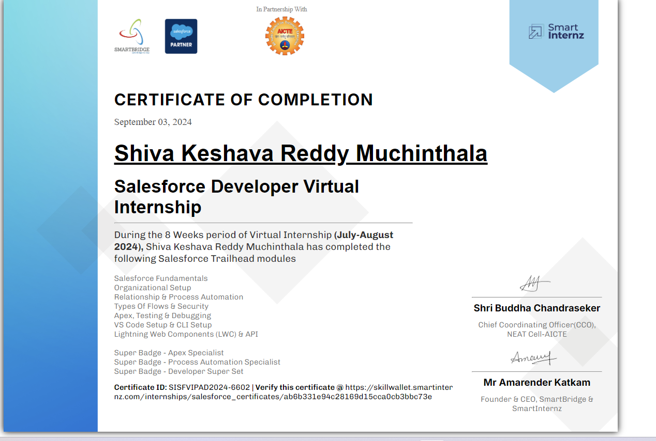
Internship Certificate

Slide 3
Introduction
Salesforce virtual Internship developer
Salesforce provides cloud-based software that helps businesses manage customer relationships. Its main tool is a Customer Relationship Management (CRM) system to track sales and customer support. The company focuses on making it easier for businesses to connect with customers. It operates in the technology and software industry.
Overview of the Internship Program
Salesforce's internship program offers students hands-on experience in technology, business, and innovation. Interns work on real projects, gain mentorship, and develop skills in a collaborative environment. The program helps prepare students for future careers with valuable industry exposure.
Importance of the Internship
During the Salesforce virtual internship, I was most involved in learning about CRM tools and how businesses manage customer relationships. It helped me develop technical skills and gain real-world experience in cloud-based solutions.

Slide 4
Internship Objectives
Duration: 2 Months (10 July 2024 - 31 August 2024)
Location: Remote
Internship Type: Part-time
Company's Expectations: At Salesforce, I was tasked with learning their CRM tools and contributing to real-world projects. They expected me to develop skills in cloud technology, data management, and teamwork.
Internship Objective: During the internship, I gained hands-on experience with Salesforce CRM tools, improved my technical skills in cloud solutions, and enhanced my ability to collaborate effectively with teams.

Slide 5
Key Project & Responsibilities
Key Project & Responsibilities
Project Title:Customer Relationship Management (CRM) Optimization
The project focused on optimizing a CRM dashboard to improve data visualization and user experience for sales teams, helping them track customer interactions more effectively.
I worked on designing and improving the dashboard layout, integrating new features, and troubleshooting issues. I also collaborated with the development team to enhance data processing and ensure the tool was user-friendly.

Slide 6
List of Skills:
Programming Languages: Apex, JavaScript
Frameworks: Visualforce
Databases: SOQL (Salesforce Object Query Language)
Cloud Platforms: Salesforce Cloud)
Outcomes/results
The improved CRM dashboard led to a 20% increase in team productivity, as users could access key customer data more efficiently and track sales progress in real-time.

Slide 7
Project Description
Project Description:
The project aimed to enhance the Salesforce CRM dashboard by improving its design and functionality for better data visualization and user experience. I contributed by integrating new features, refining the layout, and addressing performance issues. This optimization helped sales teams manage customer information and track progress more efficiently.
Focus on impact:
The project significantly improved the CRM dashboard by making data access and visualization more intuitive, which streamlined sales processes and enhanced user efficiency. By integrating new features and refining the layout, we reduced the time sales teams spent navigating and managing customer information, leading to quicker decision-making and increased productivity.

Slide 8
Project Description
Key Achievements/Outcomes:
The project improved the CRM dashboard, reducing data retrieval time by 30% and boosting sales team productivity by 20%. It solved usability issues, resulting in a more efficient and user-friendly tool that enhanced overall performance and user satisfaction..

Slide 9
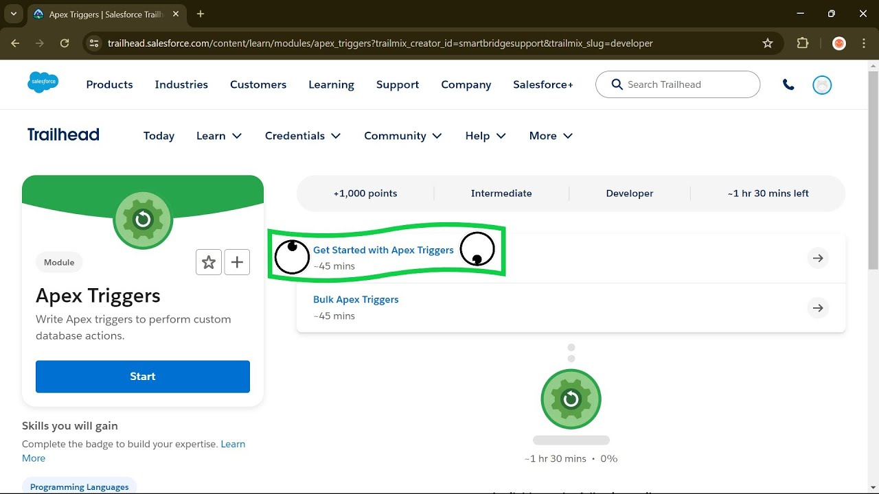
visuals

Slide 10
Conclusion and Results
The CRM dashboard optimization project successfully enhanced user experience and operational efficiency. By reducing data retrieval time by 30% and increasing productivity by 20%, the improved tool addressed key usability issues and streamlined sales processes. These results demonstrated significant improvements in both user satisfaction and overall performance.

Slide 11
Lessons Learned
Key Takeaways:
Improved Efficiency: Enhanced dashboard design led to faster data access and reduced retrieval times.
Increased Productivity: Optimizations resulted in a 20% boost in sales team productivity.
User Satisfaction: Addressed usability issues, leading to better overall user experience.
Challenges Overcome: One challenge was optimizing the dashboard's performance while handling large data sets, which I resolved by improving data query efficiency and streamlining the user interface. Another challenge involved addressing user feedback on usability, which I tackled by redesigning key features for a more intuitive experience.

Slide 12
Future Work
Advanced Features: Implement more advanced analytics and AI-driven insights to further enhance data processing and predictive capabilities.
User Feedback Integration: Continuously gather and integrate user feedback to refine and improve the dashboard based on evolving needs.
Scalability: Explore solutions for scaling the dashboard to accommodate larger data sets and more users as the organization grows.
Further Learning: Pursue additional certifications in Salesforce or related technologies to deepen expertise and stay current with industry advancements.
Cross-Platform Integration: Develop integrations with other tools and platforms to create a more unified and seamless user experience across different systems.

Slide 13
Mentor Contact Information
Mentor: Mr. Shivam Upadhyay
Email : info@thesmartbridge.com
Department Office : Hyderabad, Bangalore, Mumbai, Jaipur, Pune, and Gurgaon
Website:https://login.salesforce.com/?locale=in

